Slide 1

Exploration Tools for Automated Testing
A Web End to End Test Automation tools based on Javascript, interact with HTML element
Sentanu Eddy, May 2020

Slide 2
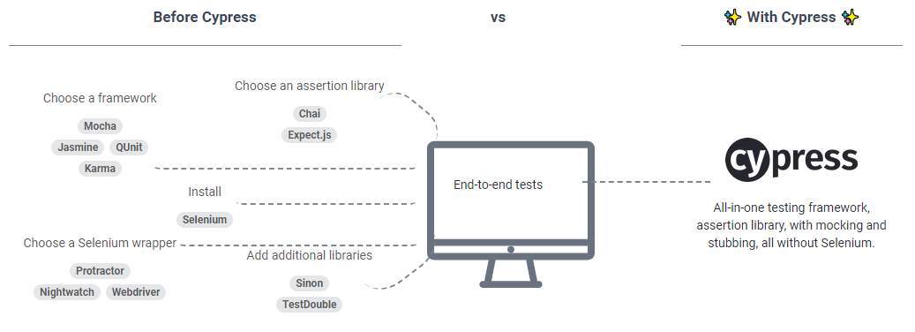
Pre-requisite
Install latest node.js with npm download LTS ver here https://nodejs.org/en/download/
Using node.js cmd install cypress : $ npm install cypress Read more
Any working code editor, using vscode or sublime text
Run Cypress
Create New nodejs project once per cypress installation
Open Dashboard Test Runner with command : $ cypress open
Run Test using command : cypress run → inside integration folder (all)
Run single test suite and specific browser : $ cypress run --spec “cypress\integration\TestName.js” --browser chrome

Slide 3
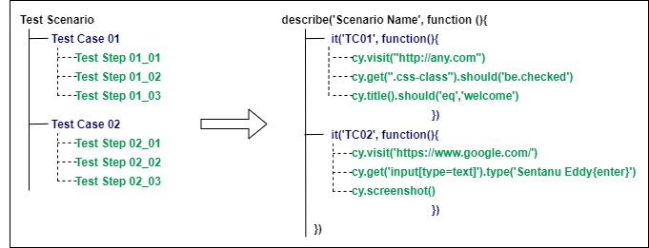
Cypress Test structure
Each Test Scenario/Suite can be run in single Javascript spec file with describe statement
Each Test Cases run inside at least 1 single Test Suite with it statement
Each Test Steps begin with cy. Function statement

Slide 4
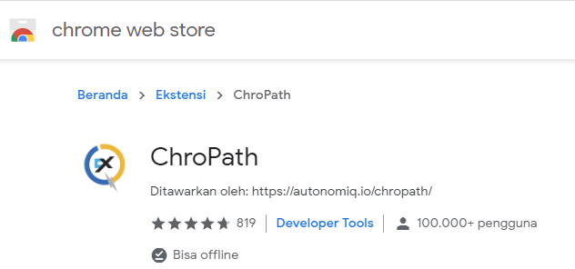
Element Locator
Working with CSS Selector concept (https://www.w3schools.com/cssref/css_selectors.asp)
Select HTML css class with ‘dot’ pointer example : .button-class
Select HTML css id with ‘hash’ pointer example : #input-text
Using combination of HTML element, attribute and value for specific locator example : input[type=text]
Using Chropath extension to make this easier, install in chrome extension

Slide 5
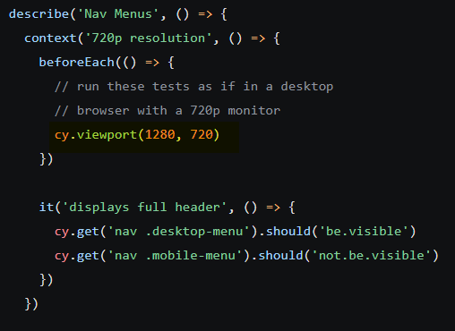
Specify Browser resolution
Using syntax viewport to minimize/maximize screen
Syntax cy.viewport(width, height) or cy.viewport('iphone-6’) for mobile view
Put this command in Test Suite, before Test Case
More, read here

Slide 6
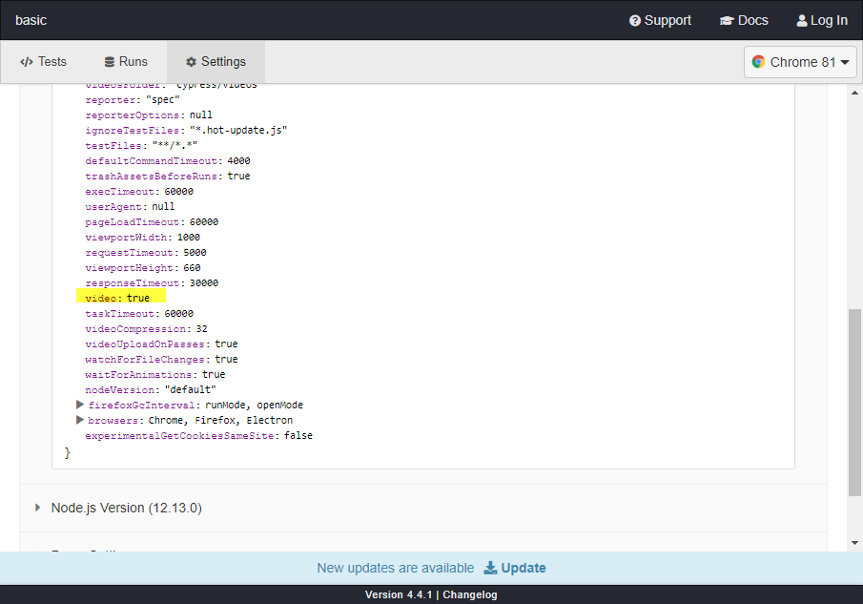
Screenshot and Record Video
By default, all screenshot are turned of, you can enable it in Test Step level using cy.screenshot() function
Screenshot location folder → projectfolder\cypress\screenshots\TestFile.js\
By default video recorder are turned on each test spec run, you can disable it by override value in cypress.json
Video location folder → projectfolder\cypress\videos\
More how to here

Slide 7
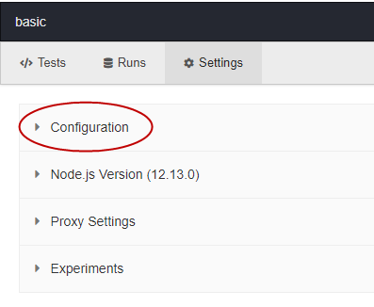
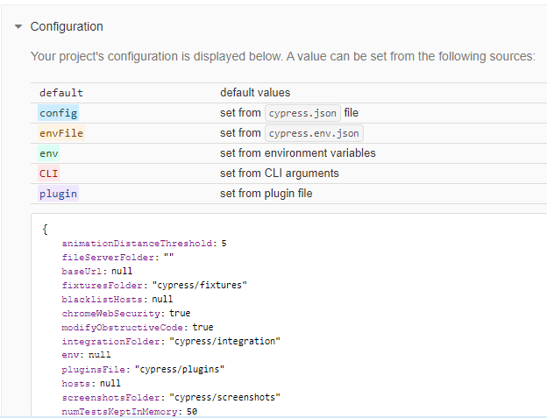
Advance Configuration - 1
Open cypress Test Run and Hover to Settings tab to see default config lists
Click Configuration markdown

Slide 8
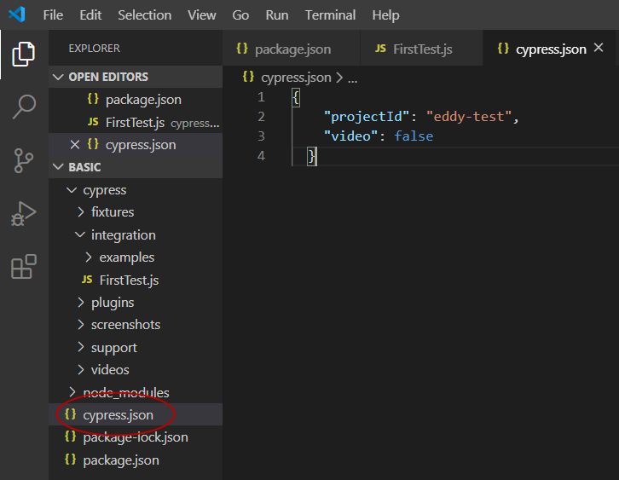
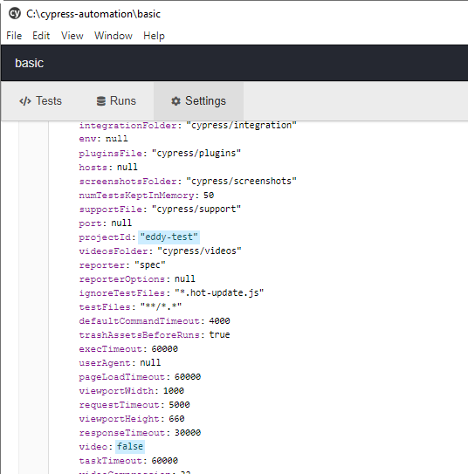
Advance Configuration - 2
Configure cypress.json (Global changes) or cypress.env.json (Multi-environment variable based changes)
Validate by re-open configuration

Slide 9
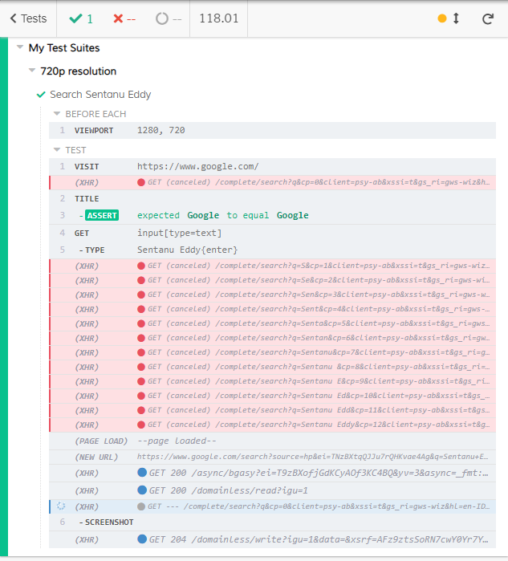
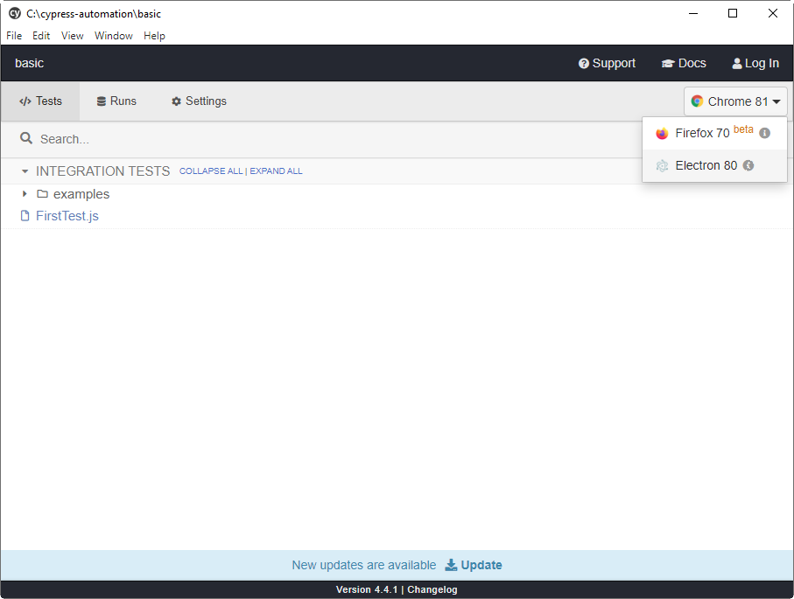
Run Test using Dashboard
Command : $ cypress open
Select Browser
Select Test File to execute

Slide 10
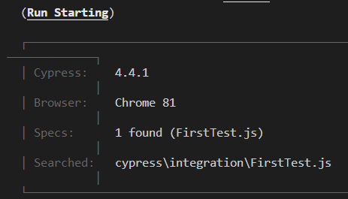
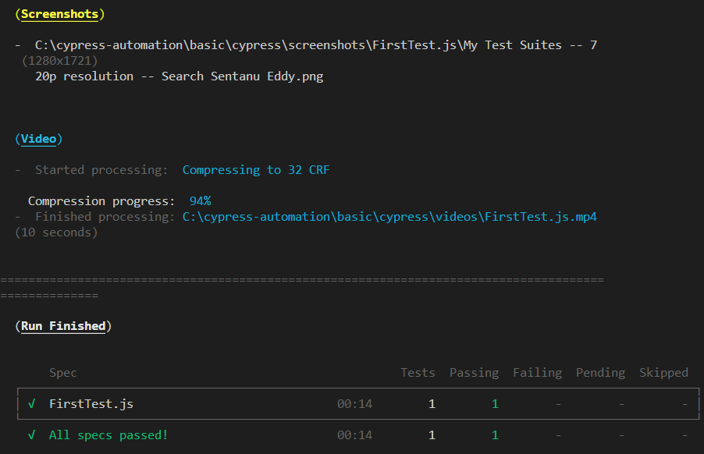
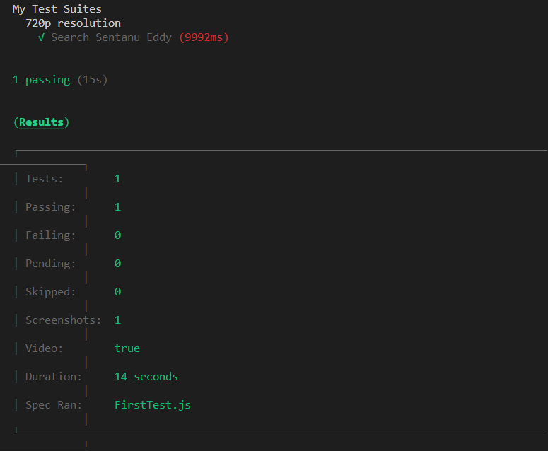
Run Test using Command
Command : $ cypress run --spec C:\cypress-automation\basic\cypress\integration\FirstTest.js --browser chrome

Slide 11
Thank You
We’ll see you next time
Sentanu Eddy, May 2020

